Slide 1
Thymosin Alpha-1

Slide 2
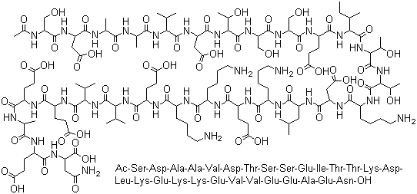
THYMOSIN
Thymosin alpha 1 (TA1)
Synthetic peptidomimetic hormone of thymosin
28 amino acids
Thymosin secreted by the thymus
Modulates innate immunity - pleiotropic

Slide 3
THYMOSIN ALPHA 1 (TΑ1)
Promotes T cell differentiation and maturation
In vivo and in vitro data
Decreases T cell apoptosis
Improves Th1 responses
Balances Th1/Th2
Activates indoleamine 2.3-dioxygenase enzyme - dampens immunity
Yang X, Qian F, He H, et al. Effect of thymosin alpha-1 on subpopulations of Th1, Th2, Th17 and regulatory T cells (Tregs) in vitrol. Braz J Med Biol Res. 2012;45(1):25-32.
Romani L, MorettiS, Fallarino F, et al. Jack of all trades: thymosin alpha-1 and its pleiotropy. Ann NY Acad Sci. 2012;1269:1-6.

Slide 4
Ta1 EFFECTS
Improves production of IL-1 beta, IFN-γ, IL-2, IL-3 , IL-6, IL-10
Improves NK cell activity and TNF-alpha
Improves macrophages and B-cells
Upregulates MHC Class I expression in antigen expressing cells
Inhibits viral replication
Improves CD3+CD4+CD8+ cells
Goldstein AL. History of the discovery of the thymosins Ann N Y Acad Sci. 2007;1112: 1– 13.
Giuliani C, Napolitano G, Mastino A et al. Thymosin-alpha1 regulates MHC class I expression in FRTL-5 cells at transcriptional level. Eur J Immunol 2000; 30:778–86.

Slide 5
Ta1 EFFECTS
Enhances dendritic cells
Enhances antibody responses
Blocks steroid-induced apoptosis of thymocytes
Anti-tumor effects
Protection against oxidative damage
Goldstein AL. History of the discovery of the thymosins Ann N Y Acad Sci. 2007;1112: 1– 13.
Haritos AA, Goodall GJ, Horecker BL. Prothymosin alpha: isolation and properties of the major immunoreactive form of thymosin alpha 1 in rat thymus. Proc Natl Acad Sci U S A 1984; 81: 1008-1011.

Slide 6
IMMUNE DYSFUNCTION (TH1-TH2 SHIFT)
Studies report immune dysfunction is associated with a wide-variety of common chronic illnesses
Chronic Stress
Depression
Metabolic Syndrome
Weigh management issues
Insulin resistance and type 2 diabetes
Anti-Aging effects – increased oxidative stress
Chronic fatigue syndrome/fibromyalgia
Autoimmune conditions
Cancer
Chronic
Environmental toxins
Chronic infections, including Lyme, viruses, candida and many parasites
Glutathione depletion consistently results in TH1-TH2 shift
Dysbiosis
Food allergies or sensitivities
Zinc and selenium deficiencies

Slide 7
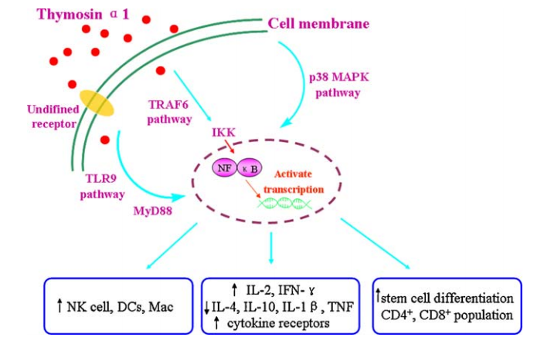
Ta1 MECHANISM OF ACTION

Slide 8
Tα1 APPLICATIONS
Conditions requiring immune response modulation
Hepatitis B and C
Treatment of HIV/AIDS
Can be used in conjunction with oral antiretroviral treatments
Cancer treatment/chemotherapy adjunct
Non-small cell lung , hepatocellular, malignant melanoma
DiGeorge’s Syndrome
Rasi G, Terzoli E, Izzo F, et al. Combined treatment with thymosin alpha 1 and low-dose interferon alpha after dacarbazine in advanced melanoma. Melanoma Res. 2000;10:189-192.
Matteucci C, Grelli S, Balestrieri E, et al. Thymosin alpha 1 and HIV-1: recent advances and future prospectives. Future Microbiol. 2017;12:141-155.

Slide 9
Tα1 APPLICATIONS
Depressed response to vaccinations
Lyme disease
Chemo attractant stimulation
Adjunct to flu vaccines especially in geriatrics
Chronic inflammatory conditions – autoimmunity
CFS/Fibromyalgia
Ershler WB, et al. Thymosin alpha 1 as an adjunct to influenza vaccine in the elderly: rational and trial summaries. Ann NY Acad Sci. 2007;1112:375-84.

Slide 10
Tα1 APPLICATIONS
Sepsis
May reduce hemoatological toxicity of cytotoxic drug therapies
Cyclphosphamide
5-fluorouracil (5FU)
Dacarbazine
Ifosfamide
Liu D, et al. The efficacy of thymosin alpha 1 as immunomodulatory treatment for sepsis: a systematic review of randomized controlled trials. BMC Infect Dis. 2016;16:488.
An TT, et al. [Primary assessment of treatment effect of thymosin alpha 1 on chemitherapy-induced neurotoxicity. Ai Zheng . 220004; 23(Suppl):1428-30.

Slide 11
Ta1 DOSAGE
General dosage
1.5 mg SubQ every 3rd day
Treatment from 2 weeks for viral infection and 3 months or longer for HIV/cancer /Hepatitis B,C or complicated immune suppression or over-activation
Multiple over-lap of usage

Slide 12
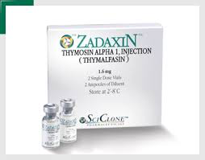
Zadaxin - Thymalfasin
Zadaxin (thymalfasin) - SciClone Pharmaeuticals – Chinese
Approved in 30 countries
FDA approved under Orphan Drug Program in US
Indicated as monotherapy or combined with interferon for treatment of Hepatitis B and C
Phase III trials for Hep C
Phase II trials for Hep B

Slide 13
Zadaxin - Thymalfasin
Zadaxin monograph also reports beneficial in
Also used in cancer and chemotherapy - immune support
HIV/AIDS – adjunct to antiretroviral therapies
Drug resistant TB
Autoimmune disorders

Slide 14
Zadaxin - Thymalfasin
Zadaxin General dosage
1.6 mg, injected SubQ, 2 times weekly for 6-12 months
Patients weighing < 40 kg, dosage adjusted to 40 mcg/kg, 2 times weekly.
1.6mg vials
Reconstitute with 1ml = 1.6mg/ml
Very low incidence of adverse effects
Notes:
Matteucci C, Grelli S, Balestrieri E, et al. Thymosin alpha 1 and HIV-1: recent advances and future prospectives. Future Microbiol. 2017;12:141-155.

