Slide 1
Thymosin Beta 4

Slide 2
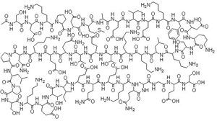
THYMOSIN Beta 4
Thymosin β-4 (TB4 or TB-500)
Originally isolated from calf thymus
More ubiquitous – occurs in most all cells
43 amino acids
Higher levels in platelets and white cells

Slide 3
THYMOSIN Beta 4 (TB4)
Up-regulates ACTIN
Main intracellular G-actin sequestering peptide
Forms a ternary complex with actin and profilin
Increases cells involved in healing
Improves cell migration to site of injury
Sanders MC, Goldstein AL, Wang Y. Thymosin B4 (Fx peptide) is a potent regulator of actin polymerization in living cells. Proc Natl Acad Sci USA. 1992;89:4678-4682.

Slide 4
THYMOSIN Beta 4 (TB4)
Promotes matrix metalloproteinase expression during wound repair
Anti-inflammatory
Promotes angiogenesis
Increased collagen deposition
Cytoprotective
Sanders MC, Goldstein AL, Wang Y. Thymosin B4 (Fx peptide) is a potent regulator of actin polymerization in living cells. Proc Natl Acad Sci USA. 1992;89:4678-4682.

Slide 5
THYMOSIN Beta 4 (TB4)
Helps decrease scar tissue formation
Reduces level of myofibroblasts
Also supports immunity
Antimicrobial
Improves T cells
Use with Thymosin alpha 1
Neuroprotective
Reti R, Kwon E, Qui P, et al. Thymosin B4 is cytoprotective in human gingival fibroblasts. Eur J Oral Sci. 2008;116(5):424-30.
Popoli PR, Pepponi A, Martire et al. Neuroprotective Effects of Thymosin B4 in Experimental Models
of Excitotoxicity. Ann. N.Y. Acad. Sci.2007;1112: 219–224.

Slide 6
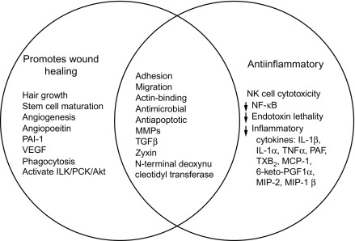
THYMOSIN Beta 4 (TB4)
Reti R, Kwon E, Qui P, et al. Thymosin B4 is cytoprotective in human gingival fibroblasts. Eur J Oral Sci. 2008;116(5):424-30.
Popoli PR, Pepponi A, Martire et al. Neuroprotective Effects of Thymosin B4 in Experimental Models
of Excitotoxicity. Ann. N.Y. Acad. Sci.2007;1112: 219–224.

Slide 7
TB4 APPLICATIONS
Soft Tissue Repair – tendon, ligament, muscle
Sports/athletic injuries
Pressure or venous stasis ulcers
Conditions requiring immune response modulation
Brain issues if autoimmunity suspected
Ischemic stroke
Kleinman HK, Sosne G. Thymosin B4 promotes dermal healing. Vitam Horm. 2016;102:251-75.
Yarmola EG, Kilmenko ES, Fujita G, et al. Thymosin beta4: actin regulation and more. Ann NY Acad Sci. 2007;1112:76-85.

Slide 8
TB4 APPLICATIONS
Spinal cord injuries
TBI / concussion (in conjunction with BPC-157)
Dry eye disorders
Phase II clinical trials – RegeneRx
Corneal injuries
Phase 3 US trial for Epidermolysis bullosa
Lung inflammation – fibrosis
May improve hair growth
Goldstein AL, Hannappei E, Sosne G, et al. Thymosin beta4: a multifunctional regenerative peptide: Basic properties and clinical applications. Expert Opin Biol Ther. 2012;12(1):37-51.

Slide 9
TB4 APPLICATIONS
Cardioprotection
Improves cardiac wound repair
Antifibrotic
Proangiogenic
Reduces infarct volume and preserves cardiac function in preclinical
models of cardiac ischemic injury.
Used in hypoxic heart disease
NAFLD ( non alcoholic fatty liver disease)
Inhibits oxidative stress
Decreases proinflammatory factors
Decrease hepatic fibrosis
Shrivastava S, Srivastava D, Olson EN, et al. Thymosin beta4 and cardiac repair. Ann NY Acad Sci. 2010;1194:87-96.
Jiang Y, Han T, Zhang Z, et al. Potential role of thymosin beta 4 in the treatment of nonalcoholic fatty liver disease. Chron Dis Trans Med. 2017;3:165-68.

Slide 10
TB4 APPLICATIONS
Decreases endotoxemia – use in sepsis
Reported in lab studies to reduce polymerization fo G-actin into F-actin
Improves mortality rate
Badamchian M, et al. Thymosin beta 4 reduces lethality and down-regulates inflammatory mediators in endotoxin-induced septic shock. Int Immunopharmacol. 2003;3(8):1225-33.

Slide 11
TB4 DOSAGE
General dosage
300 mcg – 1 gram daily, SubQ
Depending upon clinical presentation
Do not dose for more than 3 months
Cycle if needed long-term – 3 months on, 1 month off
TB4 use with Thymosin alpha 1 and BPC-157 concurrently
Individual dosage requirements may vary based on clinical presentation

Slide 12
Thank you for your attending - Any questions?
The corresponding monograph and the webinar recording will be on the website within 24 hours.

